Slide 1

Iot - Based Automate infiltrometer
Guided by – dr. debanjan das sir

Slide 2
Introduction
Problem’s Faced by using Double Ring Infiltrometer :
DRI takes more time and efforts to performed properly.
It’s required two operators for water level measurement.
Chance of human error and data loss.
DRI cannot reliably characterize infiltration of furrow irrigation, of sprinkler irrigation, or of rainfall.

Slide 3
Aim/Objective/motivation
To develop fully Automatic.
To develop a low-cost IoT device capable of measuring and cloud storing soil infiltration rate.
Show the data through applications with help of graph.

Slide 4
Concept
In this post we are going to build a water level monitoring system which can log water level data of an overhead or an underground tank to an IoT cloud called Thingspeak where we can monitor the current level of water and consumption overtime. In a previous water level monitoring system project we used GSM module (SMS) and ultrasonic sensor to render water level of a tank, here we are using IoT and the same ultrasonic technology to measure water level precisely. Measuring water level is same as measuring distance of solid surfaces, the ultrasonic transducer outputs a train of ultrasonic bursts at 40 KHz which will hit the water surface and reflect back to the sensor. The time taken between sent and received ultrasonic waves are calculated by a microcontroller such as Arduino. The measured distance is converted in to percentage.
The tank has two heights the actual water holding capacity and the total height of the tank. In any overhead tank there will be overflow and inlet tube, the point just below the overflow tube is the end of water holding capacity. You need to measure these two heights and enter it in the given program code in centimetre.

Slide 5
Tech Requirements
Network
Satellite
Link

Slide 6

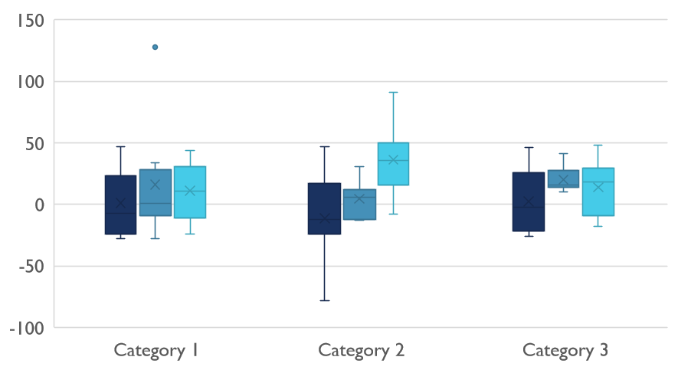
Competitive Landscape

Slide 7

Digital Communications
Cloud
Local
Hybrid

Slide 8
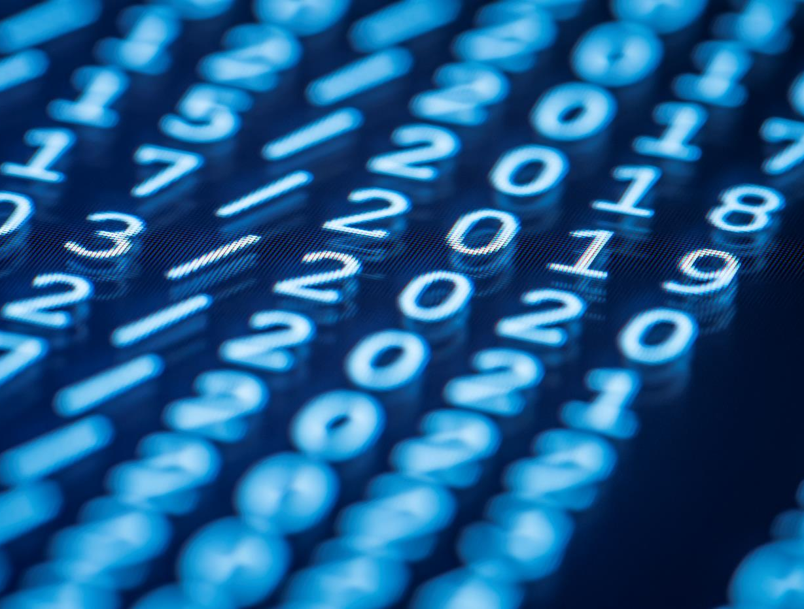
Thank You
someone@example.com

